Slide 1






MilliRide
Presented by Urban Rangers

Slide 2
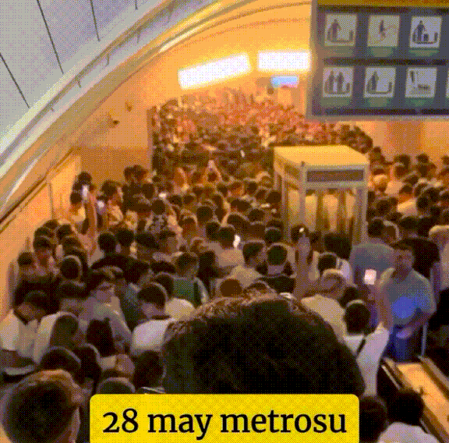
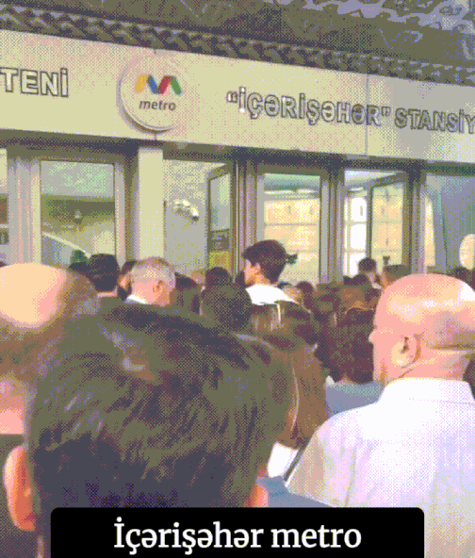
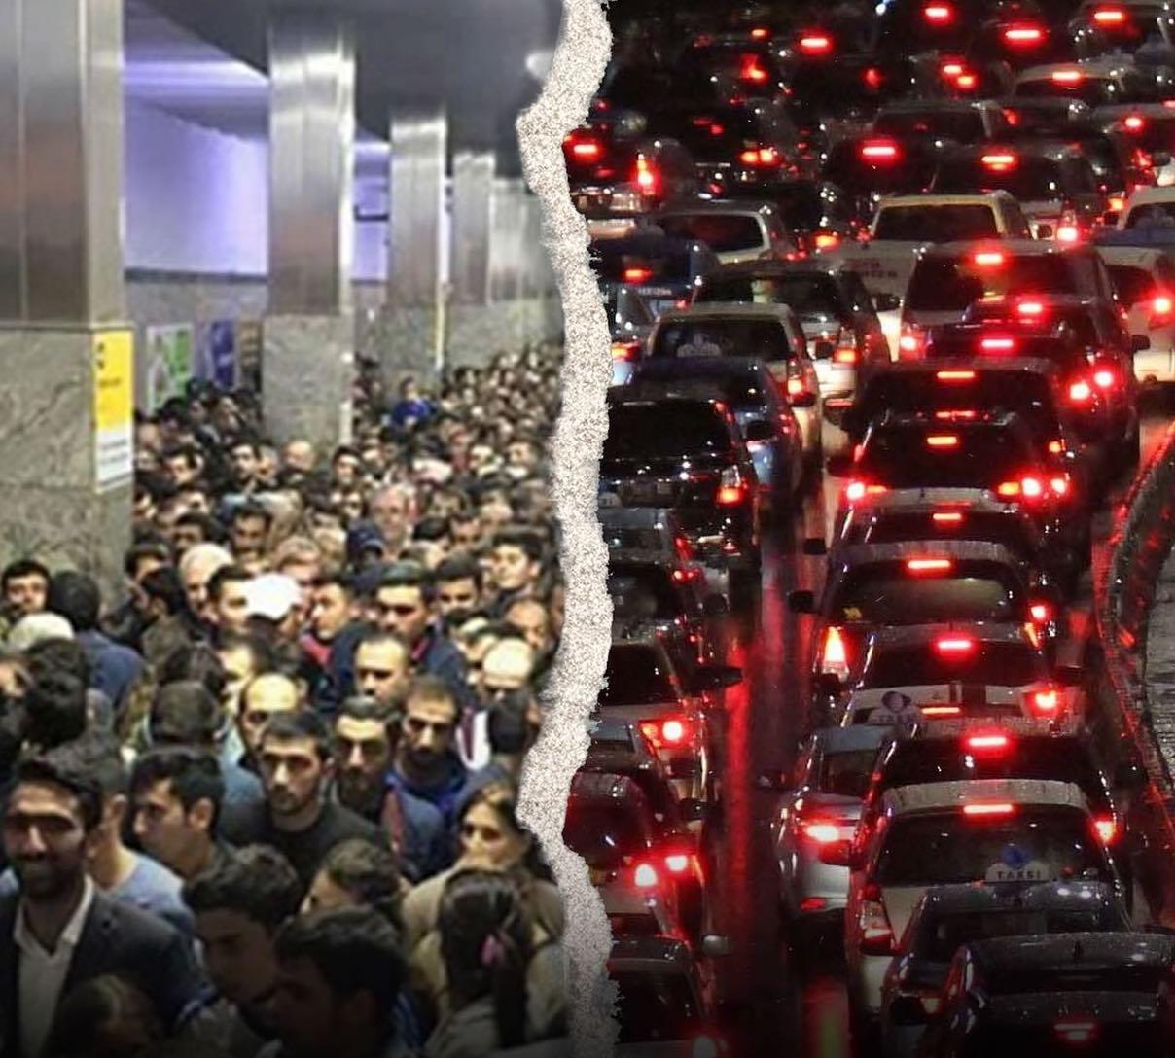
During rush hours, heavy traffic overwhelms city infrastructure and
slows down urban mobility in Baku
su

Slide 3
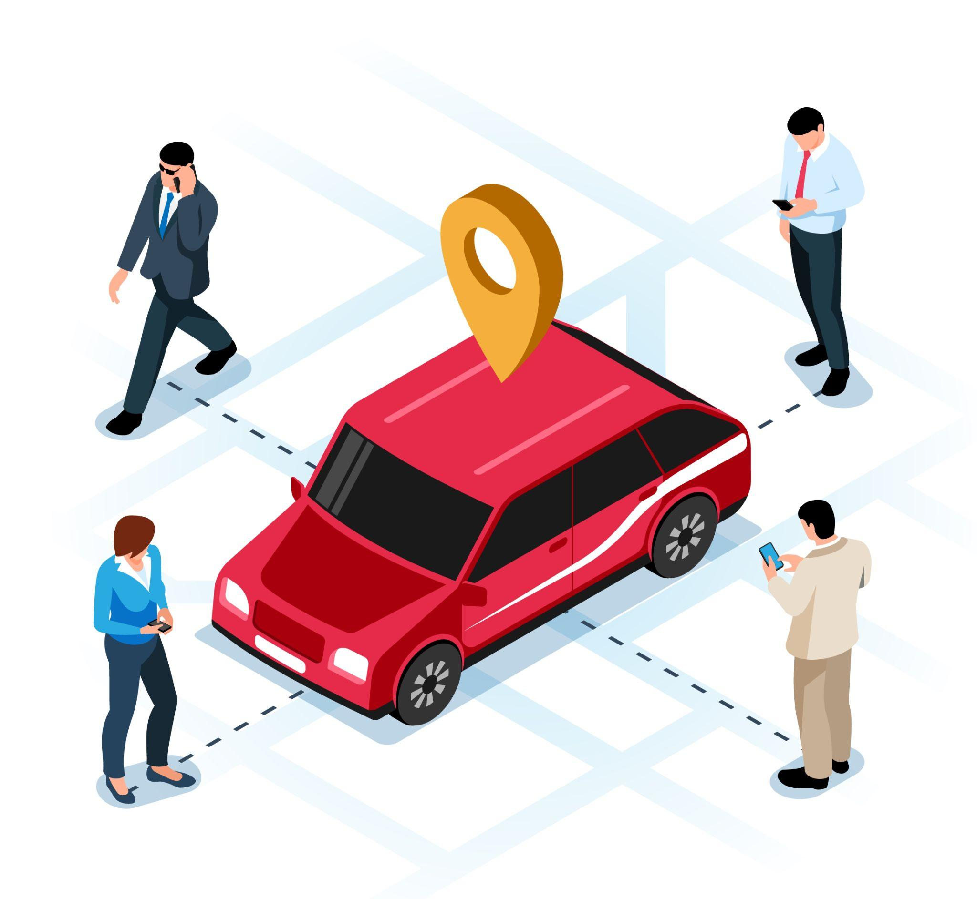
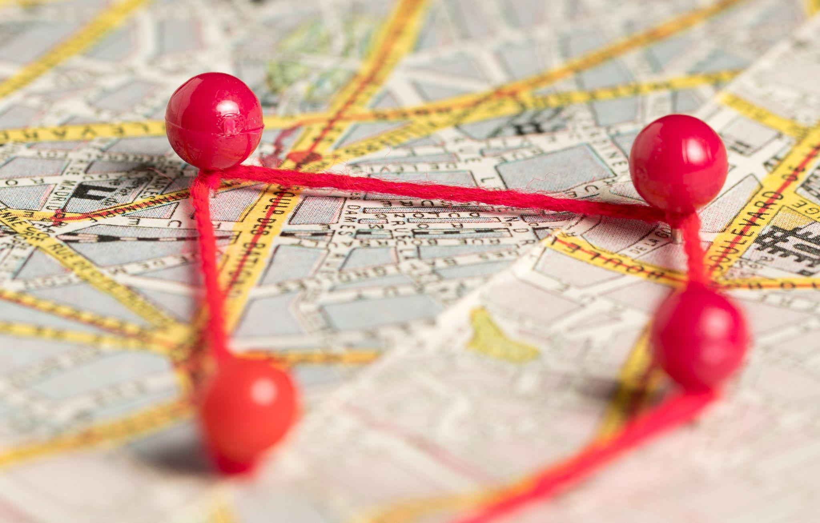
MilliRide transforms urban transport into a faster, affordable, and eco-friendly experience
Car pooling
An algorithmic approach for optimal destination clustering

Slide 4
The main question for an effective solution is:
Given a set of passengers with their destinations and drivers,
How can we group passengers for each driver so that:
Every passenger reaches their destination promptly ?
Each driver follows the most optimal route to serve their group of passengers ?

Slide 5
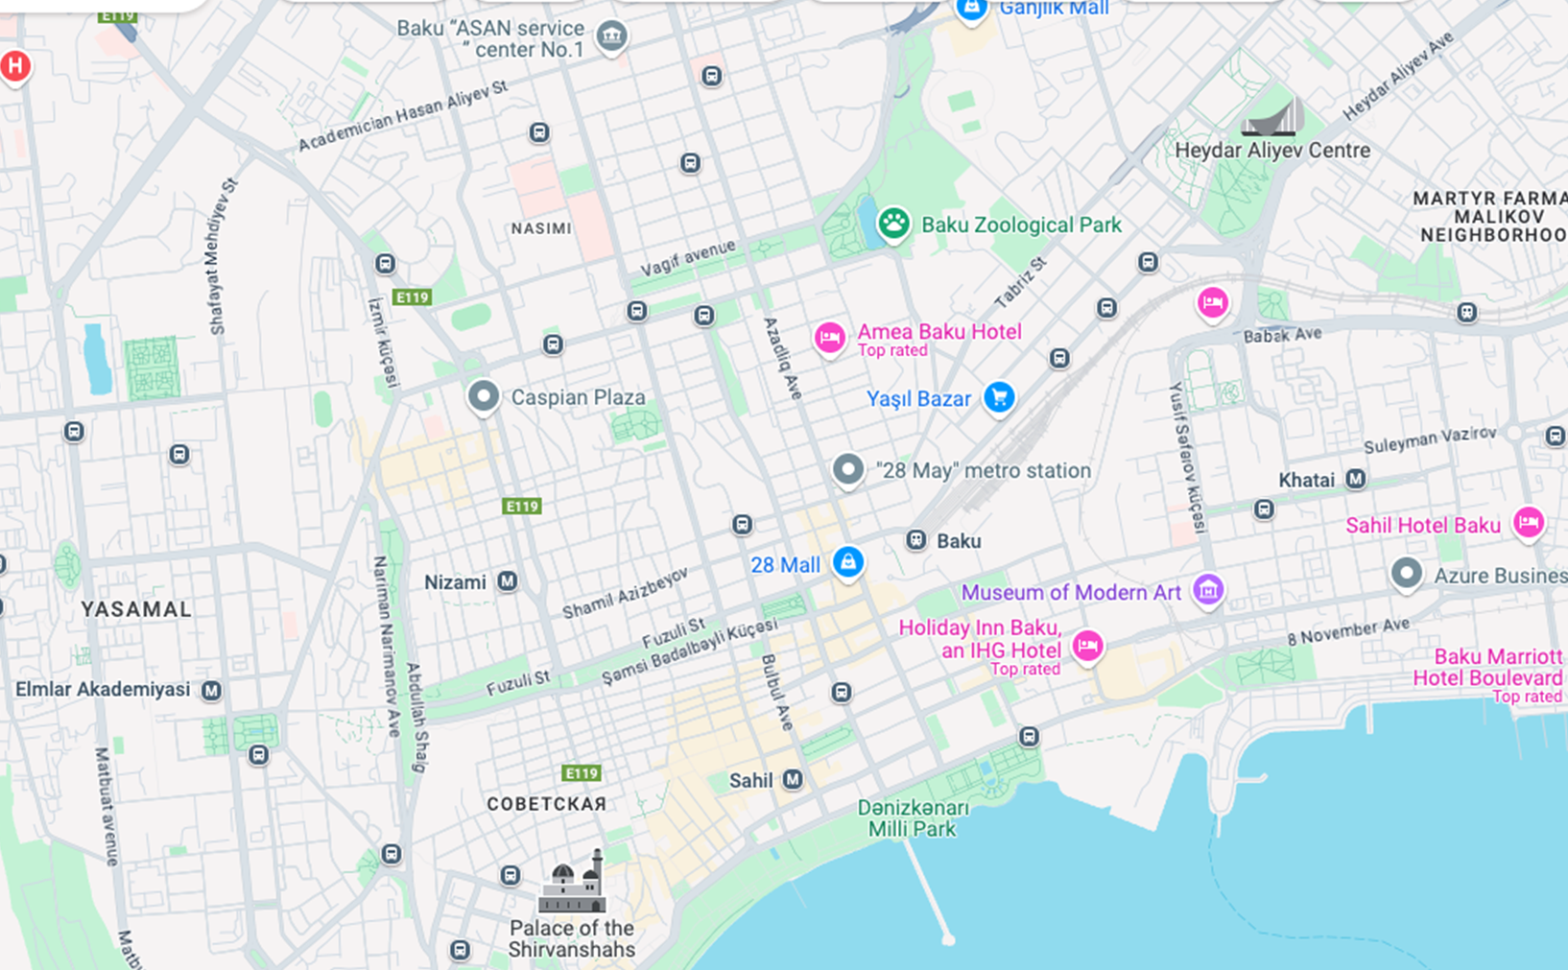

Graph Theory Approach

Slide 6

Graph Theory Approach

Slide 7
Graph Theory Approach

Slide 8
Graph Theory Approach
2.2 km
10.5 km
1.2
2.7
0.9 km
8
1.5 km
3
4
0.9
40.1
0.8 km
15.3
23.3
2.3
8.6
19.5
18
25
6.2
4.2 km
22
12.4 km
17
24.4
27
10.5 km

Slide 9
Graph Theory Approach

Slide 10
Graph Theory Approach

Slide 11
Graph Theory Approach

Slide 12
Graph Theory Approach

Slide 13
Graph Theory Approach

Slide 14
Graph Theory Approach

Slide 15
Graph Theory Approach

Slide 16
Graph Theory Approach

Slide 17
Graph Theory Approach

Slide 18
Graph Theory Approach

Slide 19
Graph Theory Approach

Slide 20
Graph Theory Approach

Slide 21






Graph Theory Approach

Slide 22
Graph Theory Approach
Routes:
1 Group
2 Group
3 Group
4 Group
5 Group
6 Group
7 Group

Slide 23
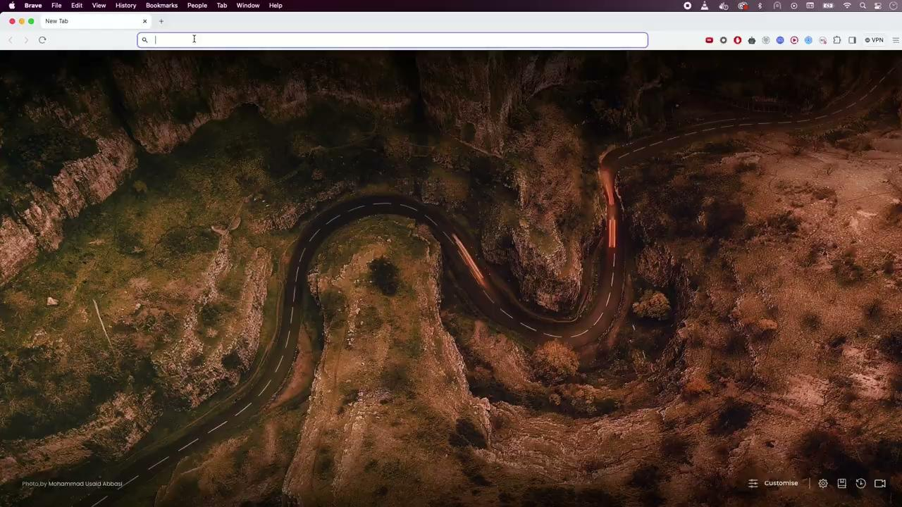
Implementation Demo
Live: https://urbanhack-production.up.railway.app (For the full experience it is advisable to access from Desktop/Laptop devices)

Slide 24


MilliRide allows passengers enjoy faster, affordable rides home while drivers get more customers per hour
Before
After
2-3 customers/hour
restricted earnings potential
higher time and fuel costs
more than 8 customers per hour
higher earnings
optimized routes & consistent demand
20-30 min waiting
higher fares
shorter waiting time
lower fares than regular

Slide 25
MilliRide transforms transport system in Baku and makes it more…
Efficient
Sustainable
reduced traffic flow
optimized route usage
increased transport capacity
reduced fuel consumption
reduced emissions from fewer cars
extended lifespan of city’s transport infrastructure
Accessible
lowered transport costs citywide
decreased wait times for everyone
expanded mobility options in all areas

Slide 26
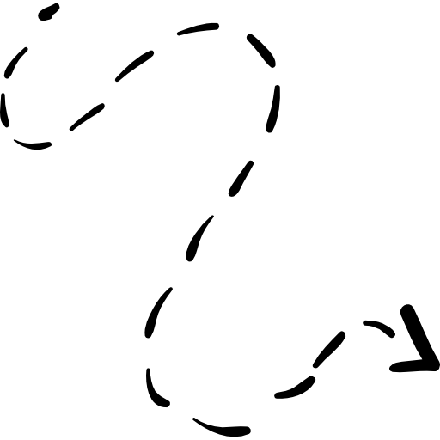
MilliRide offers scalable solutions for diverse transport use cases across the city
Enables on-demand use case for AYNA
Scalable model adaptable to other cities
Utilizes minibuses to navigate bus lanes, bypassing traffic congestion
Specialized routes can improve access in underserved areas

Slide 27

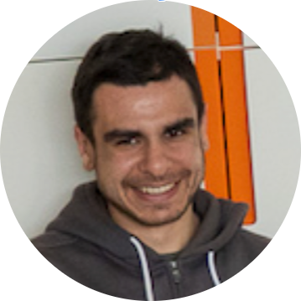
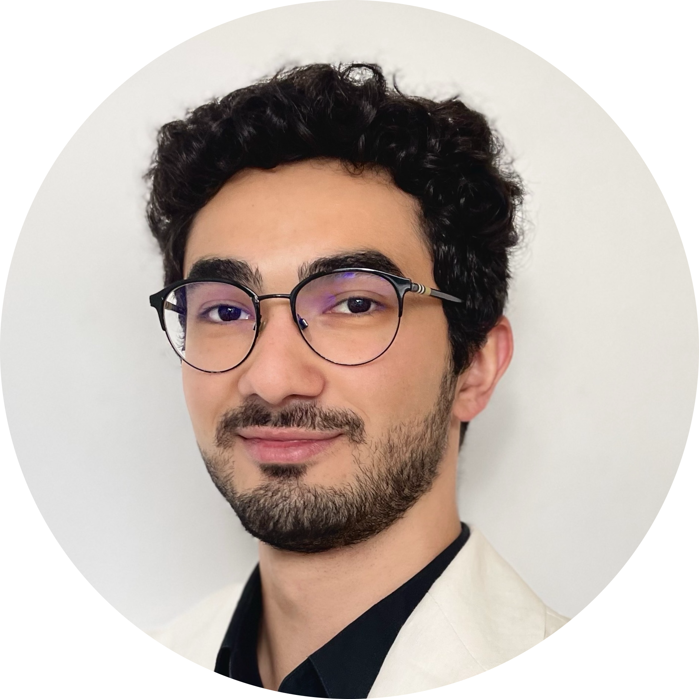

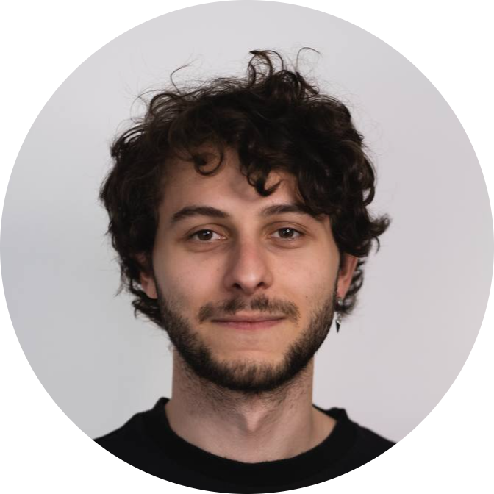



Meet our Urban Rangers team
Anar Nurizada
Dzhakhar Akperov
Ph.D. Mechanical Engineering
M.Sc. Computer Science
Yusifmilad Guluzade
Mikayil Mustafayev
Daniil Yegarmin
M.Sc. Civil Engineering
M.Sc. Robotics, Cognition, Intelligence
B.Sc. Electrical Engineering

